Slide 1





















SwarmGenomics Introduction
ATGCTTCGCGAACGTACGTCGCGAACATTATGCTTCGCGAACGTACGTACGTAGGT

Slide 2
What is SwarmGenomics?
Bioinformatics/Population genetics course
Citizen science project
Involve experts and non-experts in bioinformatic analyses
Each individual analysis is a small part of a bigger project

Slide 3
Why Relevant?
OMICS era
Genomics, Transcriptomics, Proteomics, Metabolomics, Methylomics, Meta-Genomics etc.
Rely mainly on two technologies
Mass spectrometry
DNA sequencing

Slide 4
Whole-Genome Sequencing (WGS)
Sequencing entire DNA content of an organism
Provides complete information on:
Genes
Regulatory regions
Non-coding DNA

Slide 5
Brief History of Sequencing
1970s: Sanger sequencing – first reliable DNA sequencing method
2001: Human Genome Project – first human genome sequenced
2000s onward: Next-generation sequencing (NGS) technologies → high throughput, lower cost
Today: WGS widely accessible for research and conservation

Slide 6
The Human Genome Project
Completed in 2003, the Human Genome Project produced the first “complete” human genome sequence
A composite of DNA from multiple individuals, not a single person
Using multiple samples helped cover more genetic variation and fill in gaps in difficult-to-sequence regions
The first genome represents a general human reference
Pioneered high-throughput sequencing technologies, which drastically reduced the cost and time for sequencing DNA

Slide 7
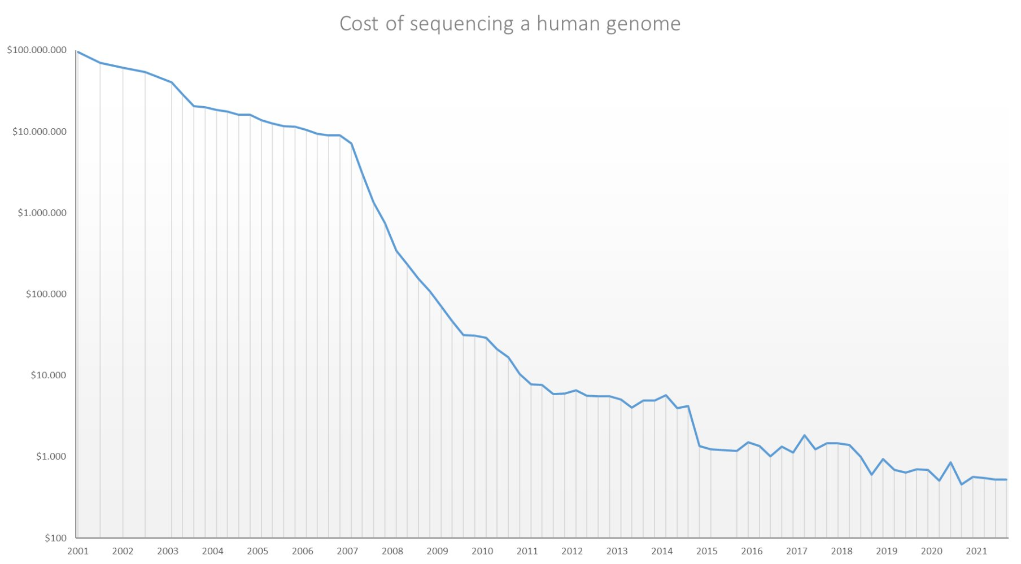
Cost of Sequencing a Human Genome
Data from: NHGRI 2024

Slide 8
Importance of WGS
Reveals genetic variation in populations
Helps understand:
Evolutionary history
Population structure
Inbreeding and genetic diversity
Supports conservation strategies for endangered species

Slide 10
DNA Sequencing Applications
Wild life conservation
Diagnostic
Biomarkers
Personalised medicine
Drug design
Forensics

Slide 11
Challenges in WGS Analysis
Massive amounts of data → complex analysis pipelines
Requires multiple specialized tools
High bioinformatics expertise needed
Reproducibility issues when combining tools

Slide 12
Learning Goals in SwarmGenomics
Key programming languages (BASH, R, python)
Important bioinformatics tools
Analysis of whole genome sequencing data

Slide 13
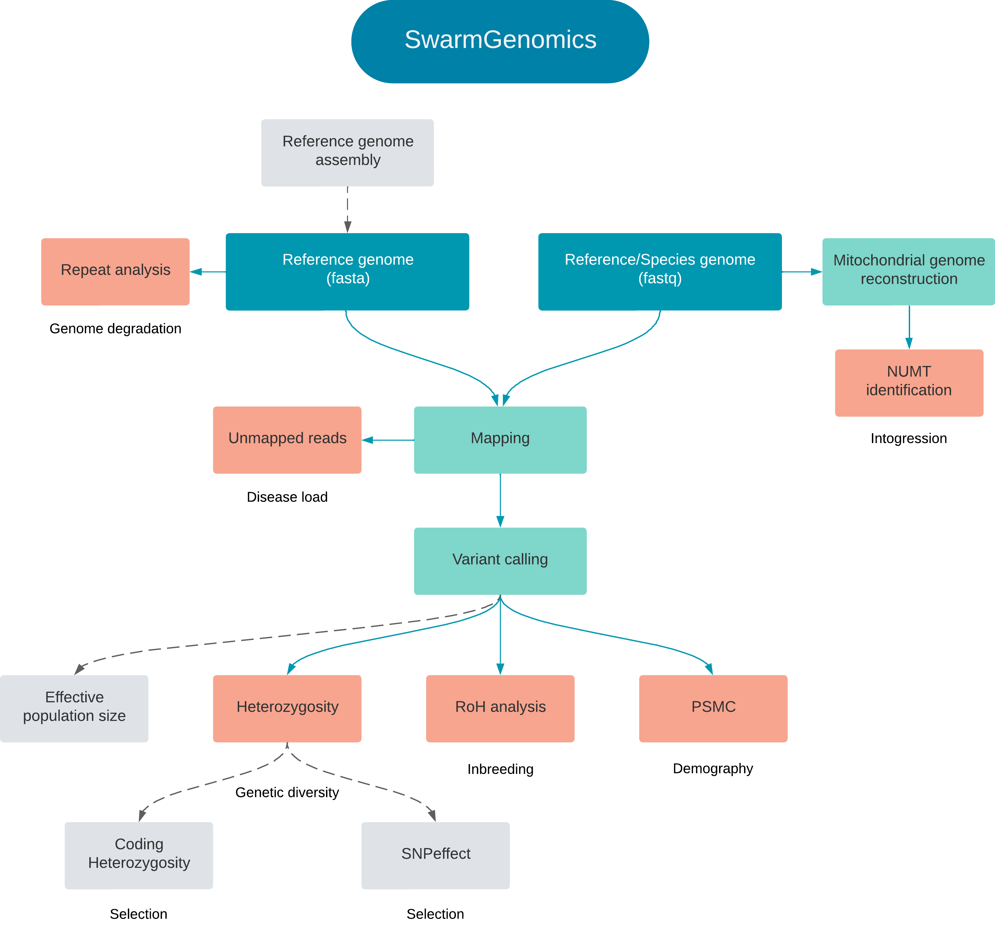

https://github.com/AureKylmanen/Swarmgenomics

Slide 14
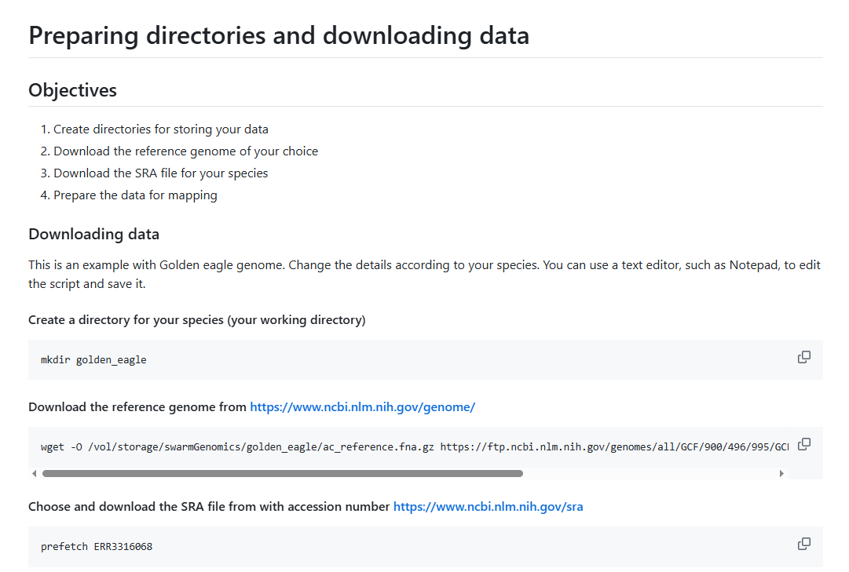
GitHub

